Slide 1
Chapter 2: Intro to Relational Model

Slide 2
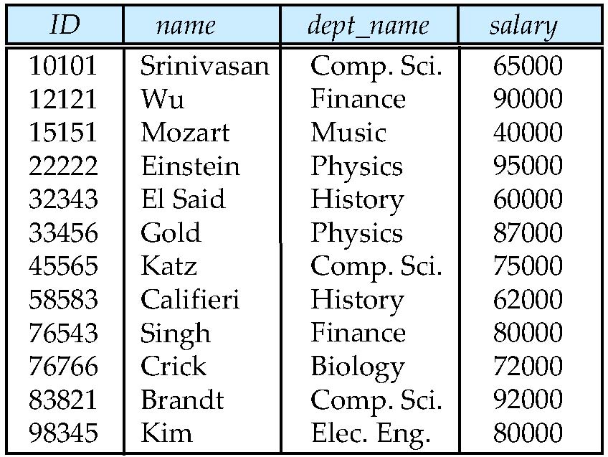
Relational Databases
The relational model is the primary data model for commercial data-processing applications today
A relational database consists of relations with a unique name
The term relation is used to refer to a table, the term tuple is used to refer to a row and the term attribute or column is used to refer to a column
The term relation instance is used o refer to a specific instance of a relation, in the example, the instance of instructor has 12 tuples
The order in which the tuples appear in a relation is irrelevant
attributes
(or columns)
tuples
(or rows)

Slide 3
Relational Databases Contd…
A domain describes the set of possible values for a given attribute, and can be considered a constraint on the value of the attribute
For instance, the domain of the salary attribute is a numeric domain.
The domains of all attributes of a relation must be atomic. A domain is atomic if elements of the domain are considered to be indivisible units
For instance, if the instructor relation has an attribute phone_number that can store a set of phone numbers associated with the instructor, the domain of phone_number would not be atomic since an element of the domain is a set of phone numbers
The null value is a special value that signifies that the value is unknown or does not exist
The null value causes complications when we access or update the database and should be eliminated if at all possible

Slide 4
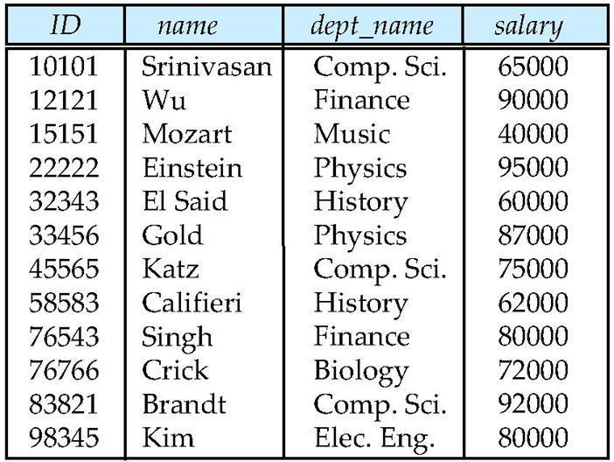
Superkey
We must have a way to specify how tuples within a given relation are distinguished
In other words, no two tuples in a relation are allowed to have exactly the same value for all attributes
A superkey is a set of one or more attributes that allow us to uniquely identify a tuple in the relation
For instance, ID is a superkey but not name in the instructor table
If K is a superkey, then so is any superset of K. So, ID and name together will also be a superkey of the instructor relation

Slide 5
Candidate Key and Primary Key
A candidate key is the minimal superkey, ie., the superkey for which no proper subset is a superkey
Example: ID is a candidate key for Instructor
There can be multiple candidate keys for a relation, for instance, id and ssn for an employee table
The primary key is the candidate key that is chosen by the database designer as the primary means of identifying tuples within a relation

Slide 6
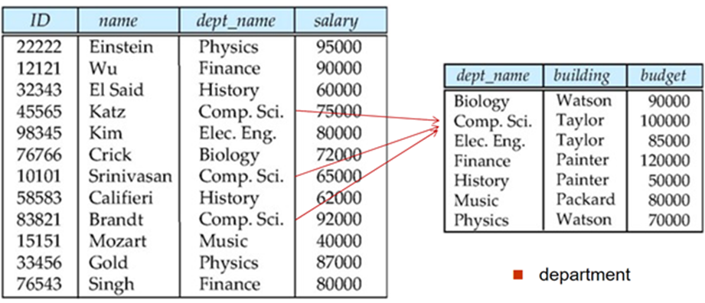
Foreign Key
A relation r1 may include the primary key of another relation r2 among its attributes. This attribute is called foreign key from r1 referencing r2
The relation r1 is called referencing relation and the r2 is called the referenced relation
Example – dept_name in instructor is a foreign key referencing department since dept_name is the primary key of department
If a value for dept_name (say Comp. Sci.) appears in instructor, then the same value should also appear in department relation. This constraint is known as a foreign key constraint and is an example of the referential integrity constraint

Slide 7
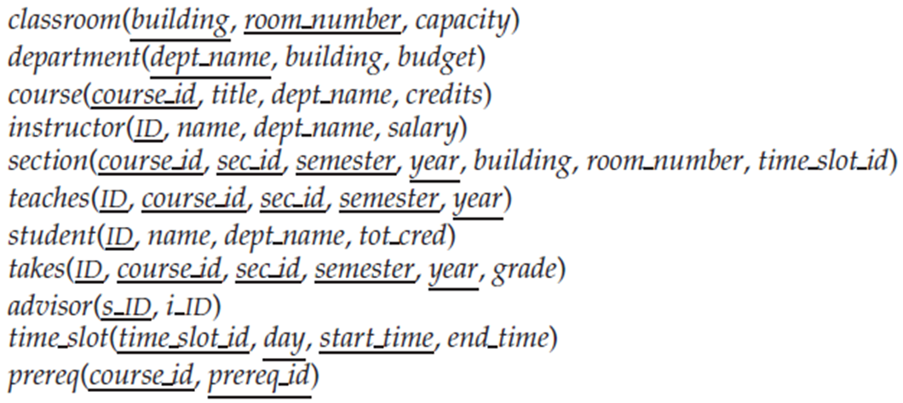
Schema of the University Database
A database schema refers to its logical design and includes all the relations as well as their attributes

Slide 8
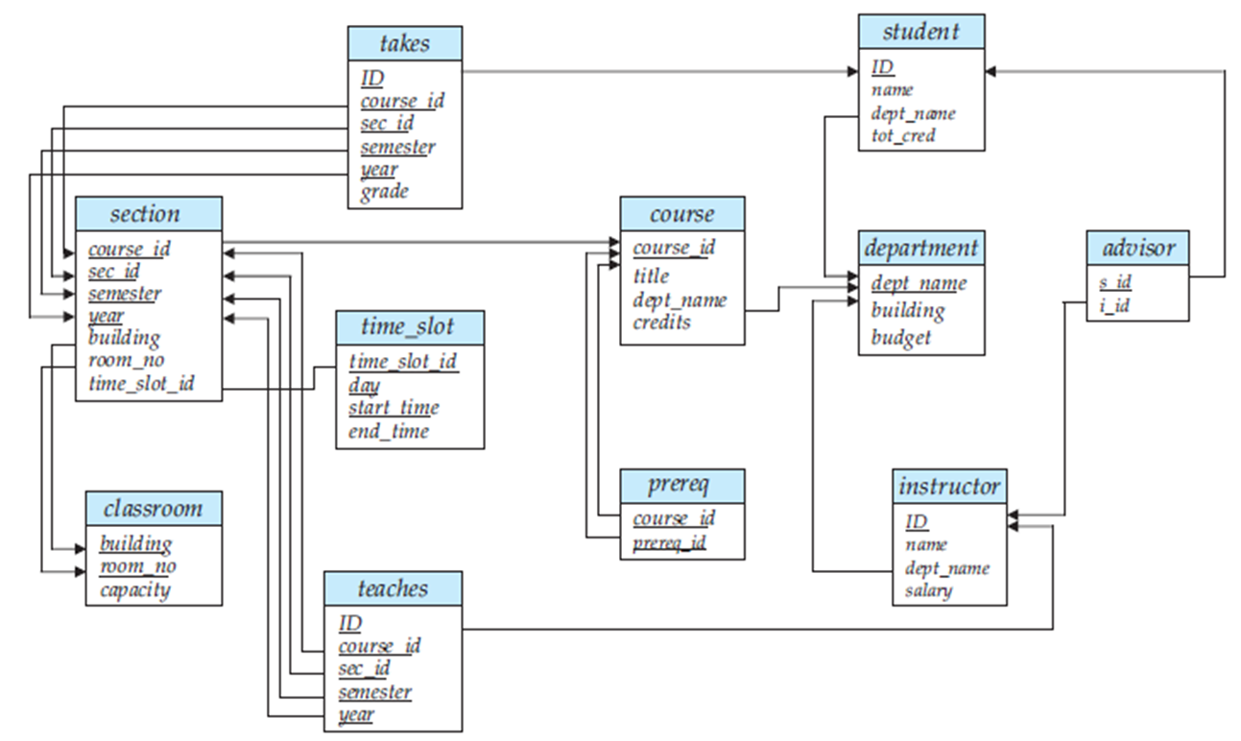
Schema Diagram for the University Database
A schema diagram is a pictorial depiction of the schema of a database that shows the relation in the database, their attributes, and primary keys and foreign keys

Slide 9
Relational Query Languages
A query language is used to request information from the database
Relational Algebra and Relational Calculus are the formal query languages that provide a theoretical foundation for relational databases and form the base for the SQL language
Relational Algebra is a procedural language while Relational Calculus is a nonprocedural (declarative) language.
In a procedural language, the user specifies the sequence of operations on the database to compute the desired result
In a nonprocedural language, the user describes the desired result without specifying the sequence of operations
The Relational Calculus has two variations namely Tuple Relational Calculus and Domain Relational Calculus.
Query languages used in practice include elements of both the procedural and the nonprocedural approaches.

Slide 10
Relational Query Languages
A query language is used to request information from the database
Relational Algebra and Relational Calculus are the formal query languages that provide a theoretical foundation for relational model
The Relational Calculus has two variations namely Tuple Relational Calculus and Domain Relational Calculus
Relational Algebra is a procedural language while Relational Calculus is a nonprocedural (declarative) language.
In a procedural language, the user specifies the sequence of operations on the database to compute the desired result
In a nonprocedural language, the user describes the desired result without specifying the sequence of operations
Query languages used in practice include elements of both the procedural and the nonprocedural approaches.
SQL is based on tuple relational calculus, and also incorporates some of the operations from relational algebra
Whereas the relational algebra defines a set of operations for the relational model, the relational calculus provides a higher-level declarative language for specifying relational queries

Slide 11
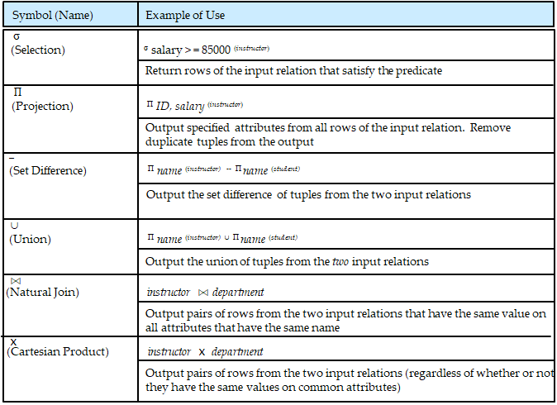
Relational Query Languages
The relational algebra provides a set of operations that take one or more relations as input and return a relation as an output.
The following table summarizes the operators in relational algebra

Slide 12
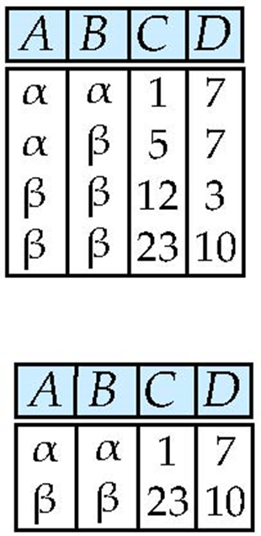
Select Operation – selection of rows (tuples)
Relation r
σ_{A=B ^ D > 5} (r)

Slide 13
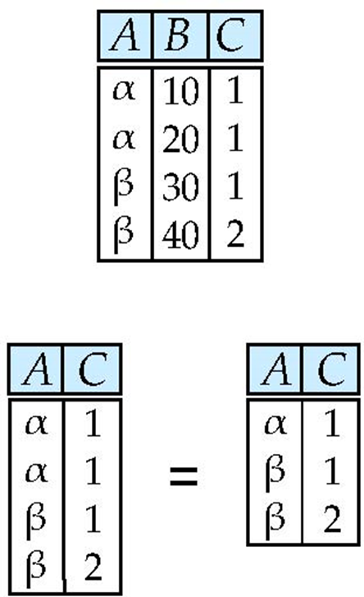
Project Operation – selection of columns (Attributes)
Relation r:
∏_{A,C} (r)

Slide 14
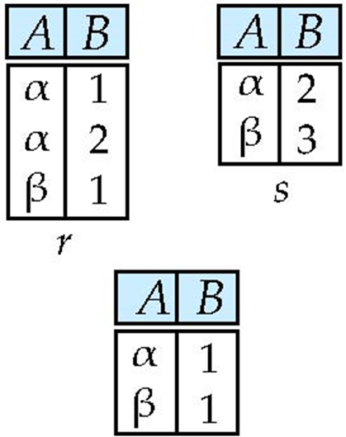
Set difference of two relations
Relations r, s:
r – s:

Slide 15
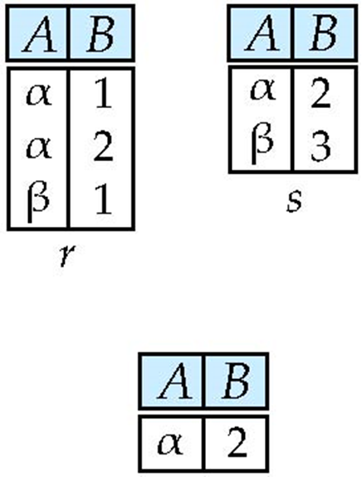
Set intersection of two relations
Relation r, s:
r ∩ s

Slide 16
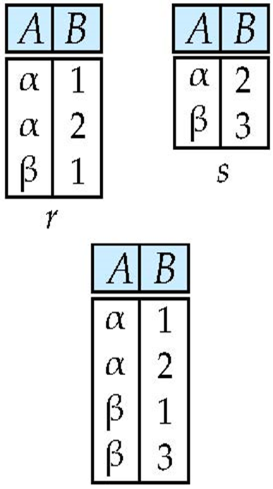
Union of two relations
Relations r, s:
r ∪ s:

Slide 17
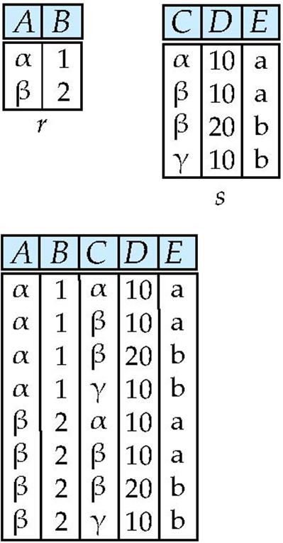
Joining two relations - Cartesian-product
Relations r, s:
r x s:

Slide 18
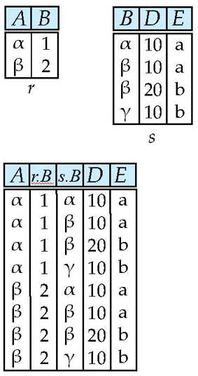
Cartesian-product – naming issue
Relations r, s:
r x s:

Slide 19

Renaming a Table
Allows us to refer to a relation, (say E) by more than one name using Greek letter rho (ρ).
ρ _{s} (r)
returns the expression r under the name s
Relation r
r.A r.B s.A s.B
r x ρ _{s} (r)
α
α
β
β
1
1
2
2
α
β
α
β
1
2
1
2

Slide 20
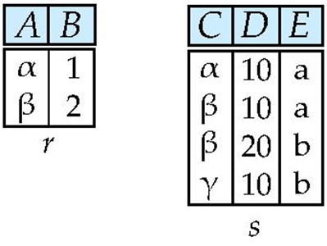
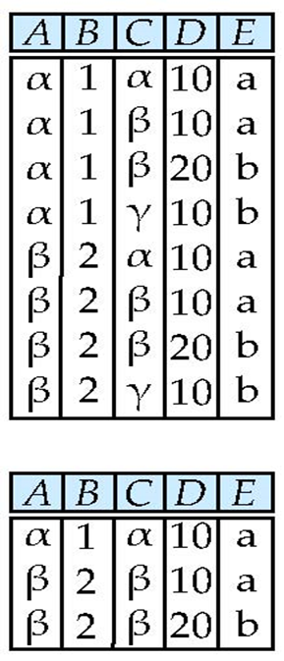
Composition of Operations
Can build expressions using multiple operations
Example: σ_{A=C} (r x s)
r x s
σ_{A=C} (r x s)

Slide 21
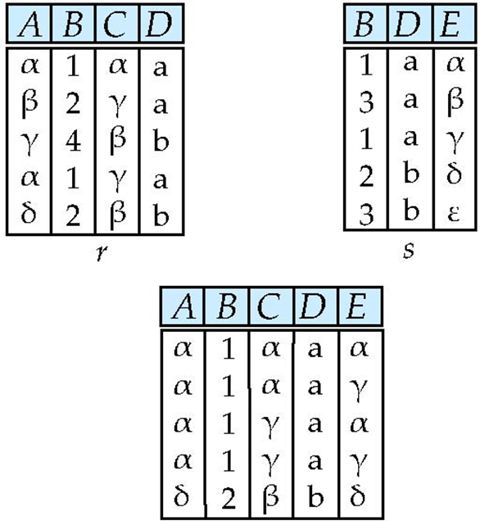
Joining two relations – Natural Join
Relations r, s:
Natural Join
r s

Slide 22
Practice Exercise 2.1
Consider the following relational database. Assume that person_name and company_name are unique attributes in the employee and company relations respectively. What would be the appropriate primary keys and foreign keys for each of these three relations?
employee (person_name, street, city)
works (person_name, company_name, salary)
company (company_name, city)

Slide 23
Practice Exercise 2.1 Answers
Primary keys are underlined below. We make an assumption that a person works for one company.
employee (person_name, street, city)
works (person_name, company_name, salary)
company (company_name, city)
Foreign Keys: person_name, company_name in works

Slide 24

Practice Exercise 2.6
Consider the following two relations.
Now, consider the following relational algebra expressions. For each expression, explain in words what the expression does.
a. σ_{year≥2009}(takes) ⋈ student
b. σ _{year≥2009}(takes ⋈ student)
c. Π_{ID,name,course_id} (student ⋈ takes)

Slide 25
Practice Exercise 2.6 Answers
σ_{year≥2009}(takes) ⋈ student
For each student who took at least one course in and after 2009, display the student's information along with the information about what courses the student took.
b. σ _{year≥2009}(takes ⋈ student)
Same as (a); selection can be done before the join operation.
c. Π_{ID,name,course_id} (student ⋈ takes)
Display a list of ID, name, course_id of all students who took any course in the university.

Slide 26
Practice Exercise 2.7
For the following relational database,
employee (person_name, street, city)
works (person_name, company_name, salary)
company (company_name, city)
give an expression in relational algebra to express each of the following queries:
Find the names of all employees who live in city “Miami”.
Find the names of all employees whose salary is greater than $100,000.
Find the names of all employees who live in “Miami” and whose salary is greater than $100,000.

Slide 27


Practice Exercise 2.7 Solutions
For the following relational database,
employee (person_name, street, city)
works (person_name, company_name, salary)
company (company_name, city)
give an expression in relational algebra to express each of the following queries:
Find the names of all employees who live in city “Miami”.
Find the names of all employees whose salary is greater than $100,000.
Find the names of all employees who live in “Miami” and whose salary is greater than $100,000.

Slide 28
Practice Exercise 2.12
For the following relational database,
employee (person_name, street, city)
works (person_name, company_name, salary)
company (company_name, city)
give an expression in relational algebra to express each of the following queries:
Find the names of all employees who work for “First Bank Corporation”.
Find the names and cities of residence of all employees who work for “First Bank Corporation”.
Find the names, street address, and cities of residence of all employees who work for “First Bank Corporation” and earn more than $10,000.

Slide 29
Practice Exercise 2.12 Solutions
For the following relational database,
employee (person_name, street, city)
works (person_name, company_name, salary)
company (company_name, city)
give an expression in relational algebra to express each of the following queries:
Find the names of all employees who work for “First Bank Corporation”.
Find the names and cities of residence of all employees who work for “First Bank Corporation”.
Find the names, street address, and cities of residence of all employees who work for “First Bank Corporation” and earn more than $10,000.

Slide 30
End of Chapter 2

